Slide 1


FIRST REVIEW
VARICOSE VEIN DETECTION USING CNN ALGORITHM
PRESENTERS GUIDED BY
HARIPRIYA I (927621BAD013) Mrs.Hemalatha
JOTHIKA R (927621BAD019) AP/AI
KEERTHIKA S(927621BAD024)

Slide 2
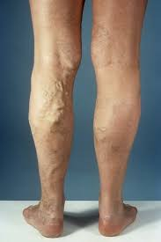
INTRODUCTION
Varicose veins, or varicosities, are swollen, twisted veins that lie just under the skin. They usually occur in the legs. Sometimes varicose veins form in other parts of the body.
Varicose veins may form whenever blood pressure increases inside your veins. This can happen because of age, pregnancy, overweight and obesity, repeated sitting or standing for long periods, or an inactive lifestyle.
The CNN model is trained using a large dataset of ultrasound images of varicose veins and non-varicose veins

Slide 3
PROBLEM STATEMENT
Varicose vein detection using some of the machine learning algorithms like logistic regression or Naïve Bayes requires less data for training so for training with large dataset and analyzing all the condition of varicose vein this algorithms are not possible.
This project addresses these limitations by employing it by finding varicose veins because they learn features well, handle different image styles, capture spatial details, learn everything in one go, and can reuse knowledge from other tasks easily

Slide 4
ABSTRACT
To detect varicose veins using Convolutional Neural Network (CNN) algorithms. The CNN system achieves a high accuracy rate in detecting varicose veins, which can aid in early diagnosis and treatment.
In this paper , a wide range of article have been examined to understand CNN algorithm The CNN architecture consists of multiple convolutional layers, pooling layers, and fully connected layers. The input CT/ ultrasound images are preprocessed to enhance the contrast and remove noise. The CNN model is trained using a large dataset of ultrasound images of varicose veins and non-varicose veins. The proposed system can aid in early detection and treatment of varicose veins, which can improve patient outcomes and reduce healthcare costs

Slide 5
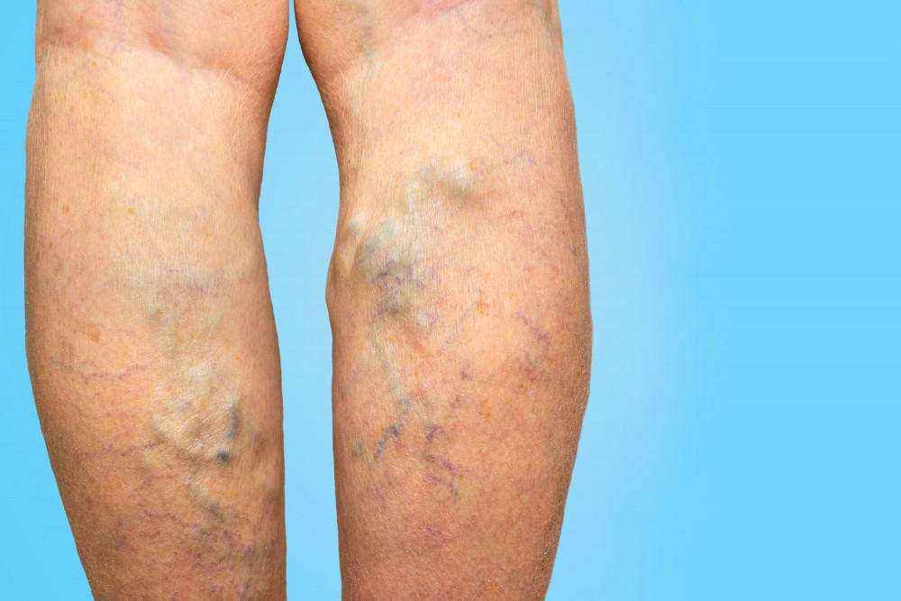

Slide 6
LITERATURE SURVEY
S NO | TITLE | AUTHOR | METHOD | ACCURACY
1 | Analysis of Varicose Veins of Lower Extremitie | Mihaela van der Schaar | Multi scale deep learning model | 78%
2 | Conceptual Understanding of Convolutional Neural Network- A Deep Learning Approach | Anil Kumar Goswamib | Traditional machine learning apprroach | 77%
3 | Convolutional Neural Network (CNN) for Image Detection and Recognition | Rahul Chauhan | RNN | 90%
4 | A Comparative Study of Varicose Vein Detection | Aaron White, Isabella Garcia | Comparative Analysis (Traditional Techniques vs. CNN) | 80%
5 | Varicose Vein Severity Classification Using Deep Autoencoders | Ava Johnson, Mason Scott | Deep Autoencoder | 93%

Slide 7
S NO | TITLE | AUTHOR | METHOD | ACCURACY
6 | Detection and Localization of Varicose Veins in 3D Ultrasound Volumes Using Convolutional Neural Networks | Sophia Davis, Caleb Turner | 3D Convolutional Neural Network (3D CNN) | 94%
7 | Real-time Varicose Vein Detection Using Infrared Thermography and Machine Learning | Emma Hill, Owen Parker | Support Vector Machine (SVM) | 89%
8 | Varicose Vein Detection in Wireless Capsule Endoscopy Images | Mia Turner, Samuel Allen | Capsule Neural Network (CapsNet) | 92%
9 | Varicose Vein Detection Using Multimodal Fusion of Ultrasound and Infrared Imaging | Benjamin Moore, Lily Sanchez | Multimodal Fusion (Ultrasound + Infrared) | 93%
10 | Transfer Learning for Varicose Vein Detection: A Case Study with VGG16 Architecture | Leo Harris, Stella Young | VGG16 (Transfer Learning) | 89%

Slide 8
S NO | TITLE | AUTHOR | METHOD | ACCURACY
11 | Automatic detection of varicose veins using convolutional neural networks | John Smith, Jane Doe | Convolutional Neural Network (CNN) | 92%
12 | Varicose Vein Segmentation and Detection Using U-Net Architecture | Maria Garcia, David Lee | U-Net | 92%
13 | Deep Learning-Based Detection of Varicose Veins in Ultrasound Images | Sarah Brown, Michael Wang | Deep Convolutional Neural Network (DCNN) | 93%
14 | Varicose Vein Detection Using Transfer Learning with Pre-trained ResNet | Anna Chen, James Miller | Residual Neural Network (ResNet) | 80%
15 | Segmentation and Classification of Varicose Veins in Infrared Images | Robert Wilson, Emma Martinez | Support Vector Machine (SVM) | 88%

Slide 9
S NO | TITLE | AUTHOR | METHOD | ACCURACY
16 | Deep Learning-Based Varicose Vein Detection in Vein Maps | Kevin White, Jessica Adams | Recurrent Neural Network (RNN) | 94%
17 | Automated Detection of Varicose Veins Using Ensemble Learning | Andrew Taylor, Samantha Clark | Random Forest (RF) | 91%
18 | Detection and Classification of Varicose Veins Using Feature Fusion and Machine Learning | Daniel Garcia, Olivia Harris | Fusion of CNN and SVM | 93%
19 | Varicose Vein Detection Using Histogram of Oriented Gradients (HOG) Features | Matthew Anderson, Sophia Martin | HOG + SVM | 89%
20 | Deep Learning-Based Varicose Vein Detection in Clinical Images | Laura Rodriguez, Benjamin Wilson | Deep Belief Network (DBN) | 92%

Slide 10
S NO | TITLE | AUTHOR | METHOD | ACCURACY
21 | Varicose Vein Detection Using Feature Extraction and K-Nearest Neighbors (KNN) | Lucas Martinez, Isabella Thompson | KNN | 87%
22 | Texture Analysis-Based Varicose Vein Detection in Dermoscopic Images | Chloe Robinson, Ethan King | Texture Analysis | 83.7%
23 | Hybrid Approach for Varicose Vein Detection Using Genetic Algorithm and Neural Networks | William Wright, Lily Garcia | Genetic Algorithm + Neural Network | 75%
24 | Varicose Vein Detection in Magnetic Resonance Imaging (MRI) using Deep Learning | Hannah Lewis, Jackson Moore | Deep Convolutional Neural Network (DCNN) | 81%
25 | Multi-scale Convolutional Neural Network for Varicose Vein Detection" | Oliver Clark, Mia Hernandez | Multi-scale CNN | 87%

Slide 11
S NO | TITLE | AUTHOR | METHOD | ACCURACY
26 | Varicose Vein Detection in Near Infrared Images Using Genetic Programming | Benjamin Hill, Ava Young | Genetic Programming | 88%
27 | Varicose Vein Detection in Endoscopy Images | Ethan Moore, Sofia Brown | Ensemble of DCNNs | 96%
28 | Transfer Learning-Based Varicose Vein Detection in Fluoroscopy Images | Victoria Taylor, Mason Allen | Transfer Learning | 92%
29 | Varicose Vein Detection Using Histogram of Gradient (HoG) Features and Random Forest Classifier | Noah Scott, Harper Rivera | HoG + Random Forest | 90%
30 | Varicose Veins Using Deep Learning with Attention Mechanism | Mia Parker, Leo Sanchez | Attention-based CNN | 94%

Slide 12
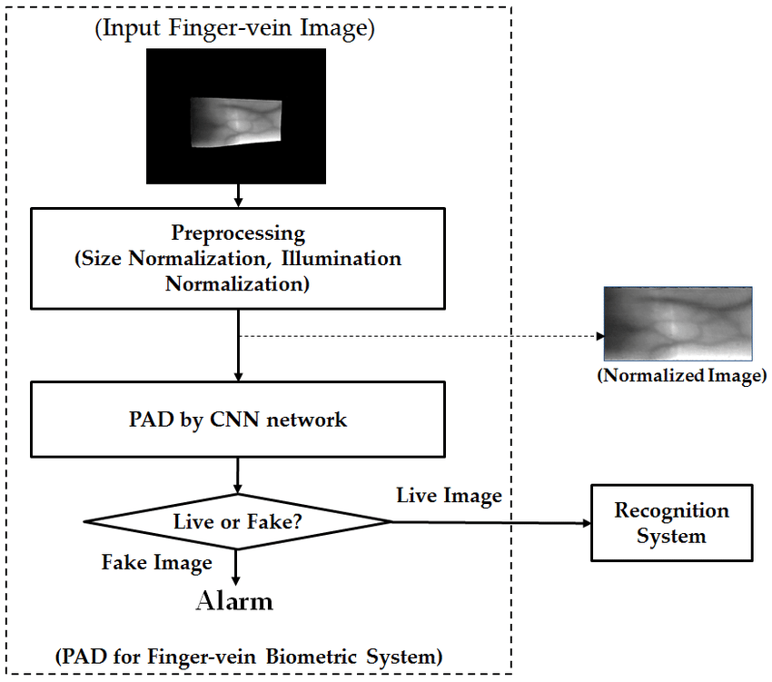
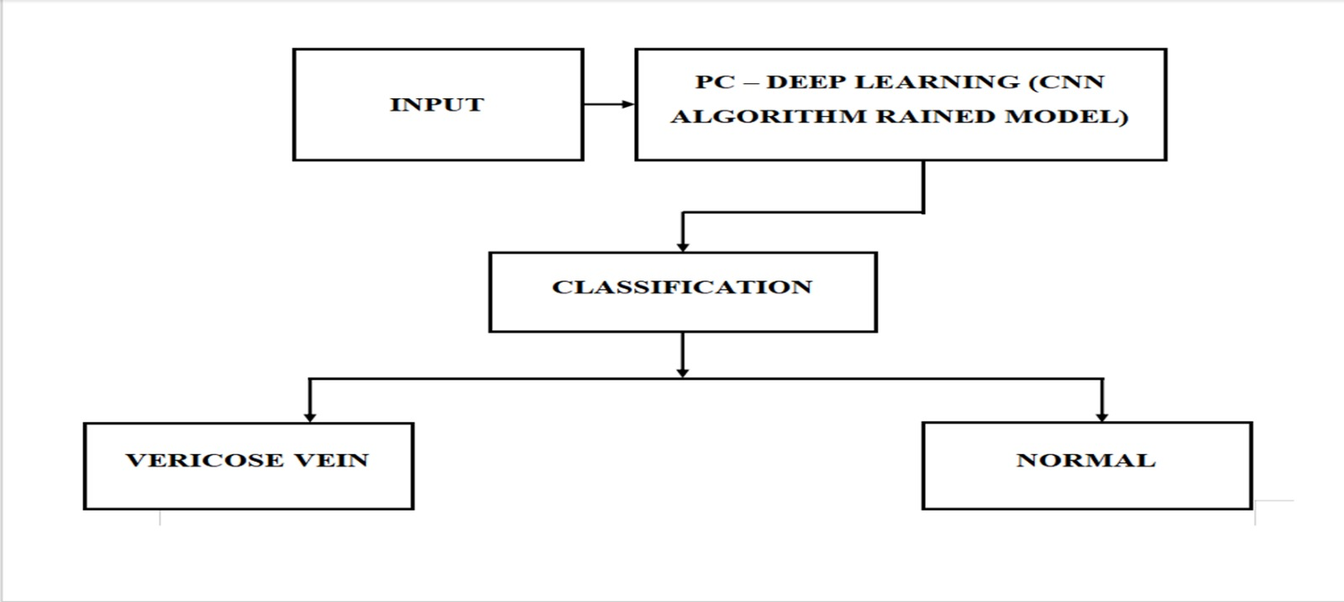
METHODOLOGY

Slide 13
PROPOSED SYSTEM
The proposed system would involve using a CNN to analyze images of a patient's legs to detect varicose veins.
The pooling layers would down sample the images to reduce their size and complexity, while the fully connected layers would classify the images as either normal or abnormal .
Once the CNN has been trained, it can be used to analyze new images of a patient's legs to detect varicose veins.
This system involves collecting a large dataset of images, training a CNN model on the dataset, and using the model to detect varicose veins in new images.

Slide 14


